Slide 1
Version Control for Code
Indra Azimi, S.T., M.T.
D3 Teknik Informatika, Telkom University

Slide 2

GOAL: Using Version Control

Slide 3
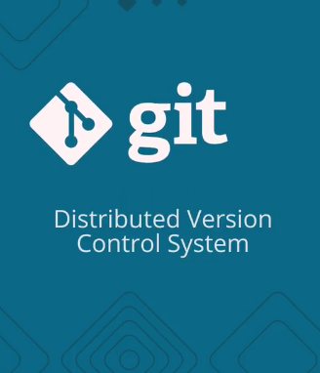
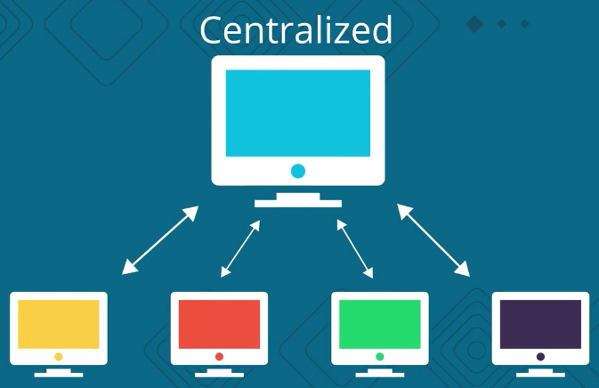
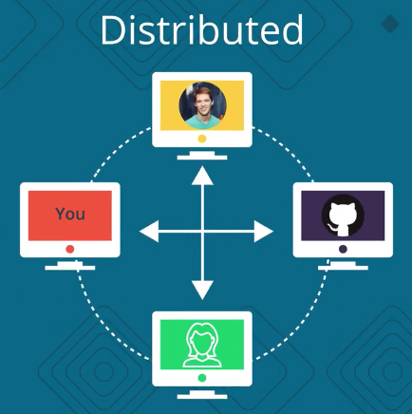
Centralized vs Distributed

Slide 4
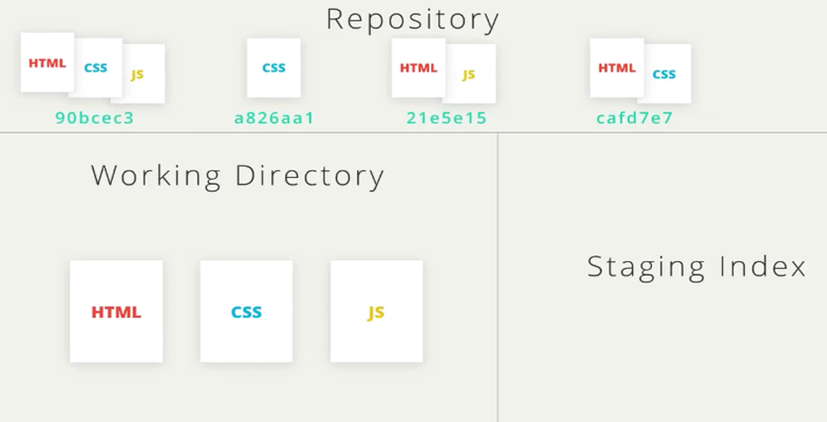
version control workflow
git commit
git add

Slide 5
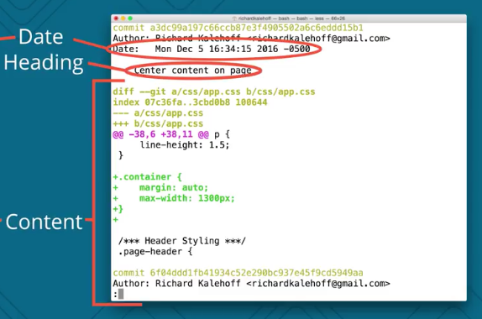
Commit Example

Slide 6
Commit Messages
do keep the message short (less than 60-ish characters)
do explain what the commit does (not how or why!)
do not explain why the changes are made
do not explain how the changes are made (that's what git log -p is for!)
do not use the word "and"
if you have to use "and", your commit message is probably doing too many changes - break the changes into separate commits
e.g. "make the background color pink and increase the size of the sidebar"

Slide 7
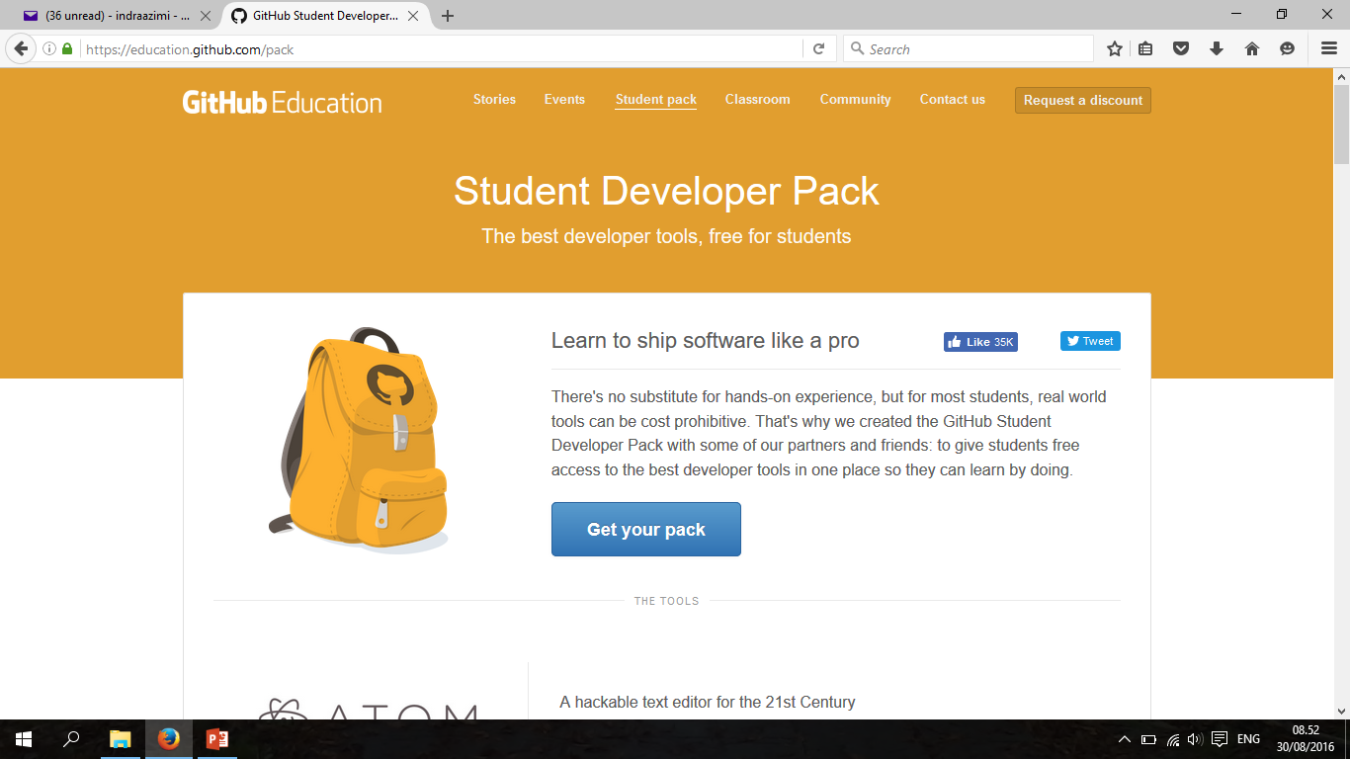
Github Education
https://education.github.com/pack

Slide 8




















Akses gratis dev. tools senilai $3.000+
Notes:
Udacity Student Developer Pack members get one month free access to any Nanodegree program (normally $199)

Slide 9
Tugas
Buat akun Github di https://github.com/
Gunakan nama lengkap
Gunakan foto terbaru
Daftarkan tim tugas besarmu di https://classroom.github.com/g/fPJ2DZo6
Format nama tim → Kelas-NamaAplikasi
Contoh → 3905-Nothing
Saat praktikum, bawa laptop masing-masing. Harus sudah terinstall Git, download dari https://git-scm.com/downloads

Slide 10
Referensi
Version Control with Git
https://www.udacity.com/course/ud123
How to use GitHub with Android Studio
https://www.londonappdeveloper.com/how-to-use-git-hub-with-android-studio/

